Slide 1


FAISys 2025
General Chairs’ Welcome Address
The 1st Frontier AI Systems Workshop
Nov. 14-15, 2025
CUHK, Hong Kong, China

Slide 2

FAISys 2025
Why Do We Start FAISys?
Accelerate new ideas
Invited arXiv talks (by senior PC)
Address long-term challenges
Grand challenge proposals
Notes:
整张图片

Slide 3
FAISys 2025
157
registrations
Notes:
整张图片

Slide 4
FAISys 2025
Participants from Industry and Academia
Industry: 72
Academia: 85
Notes:
整张图片

Slide 5
FAISys 2025
Participants from Industry and Academia
Notes:
参会者分布备选方案三

Slide 6
FAISys 2025
1 Keynote
4 Grand challenge proposals
and a panel discussion
12 Invited arXiv talks
9 Regular paper talks
All papers are accessible from the program webpage
Notes:
左边文字右边图

Slide 7
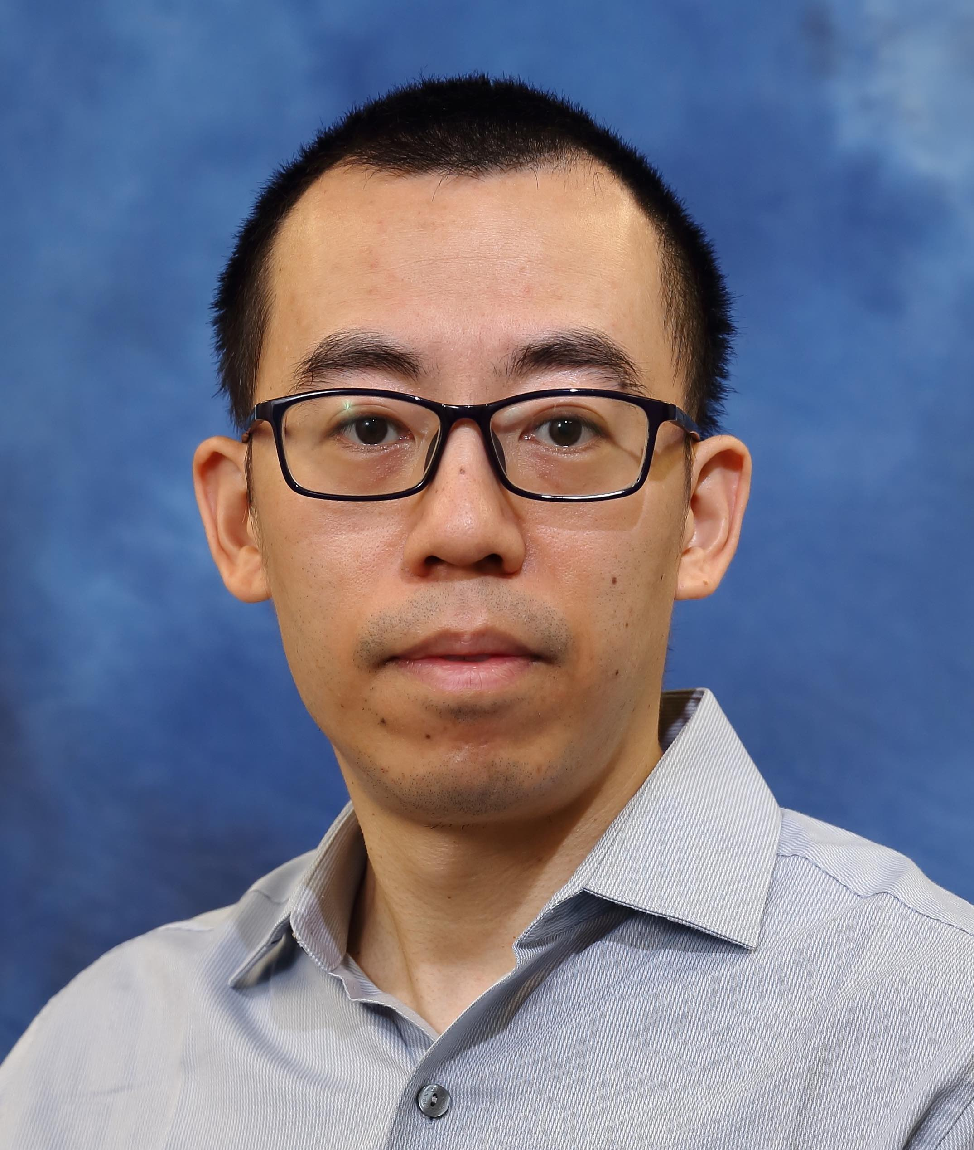
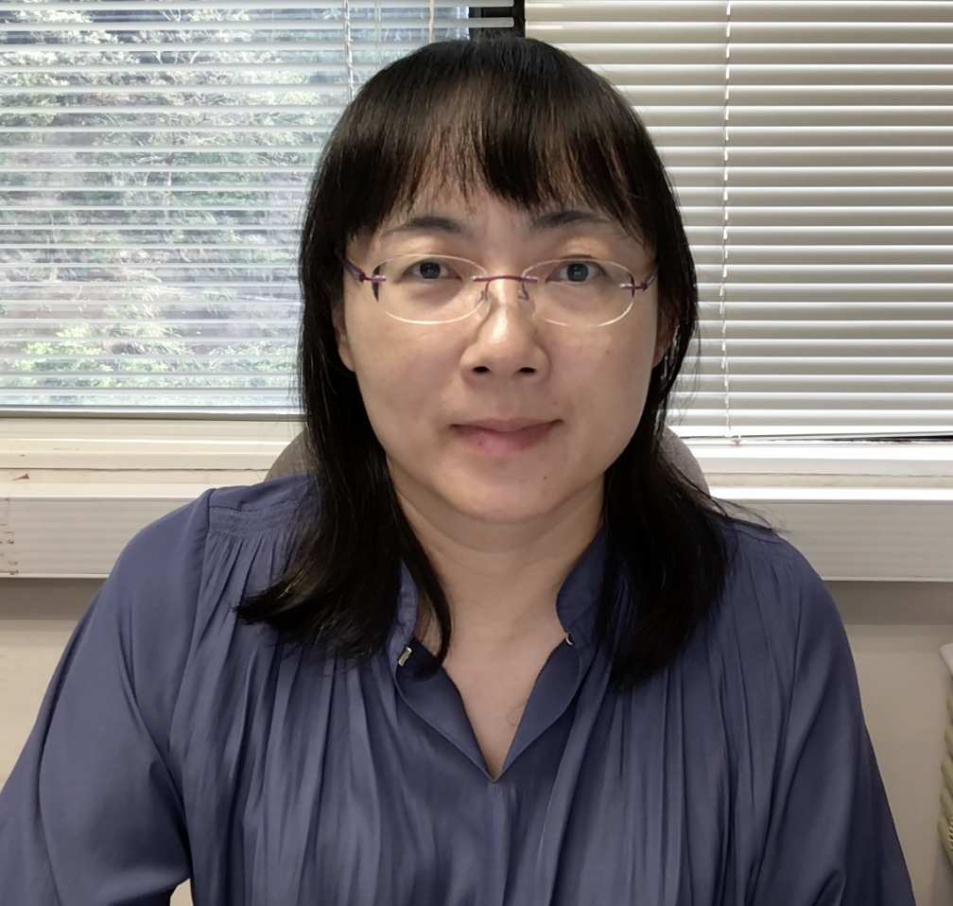
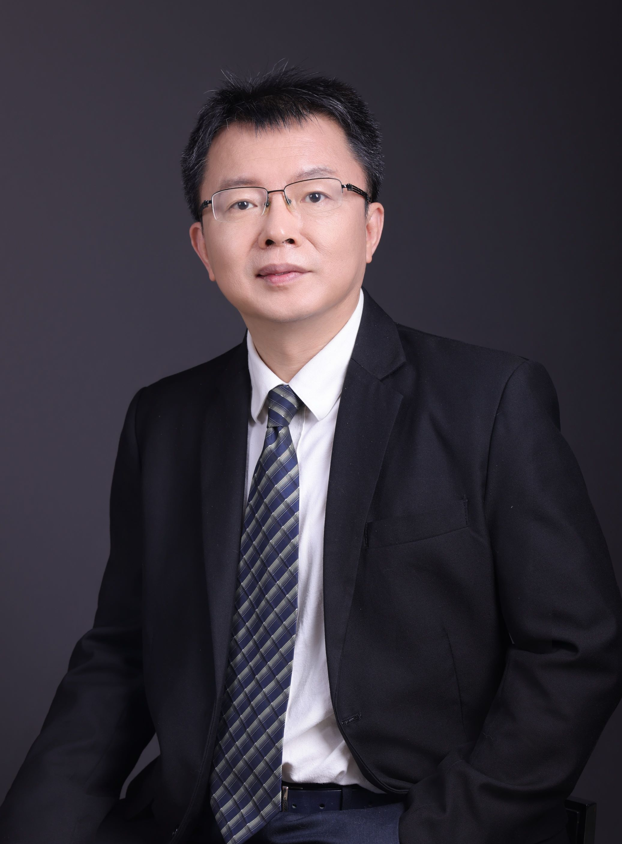
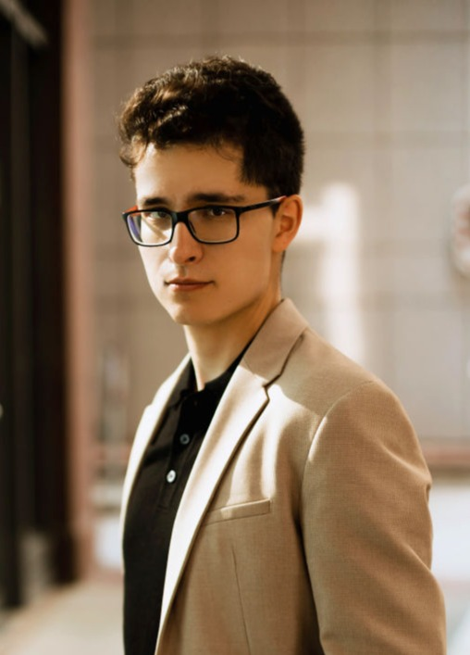
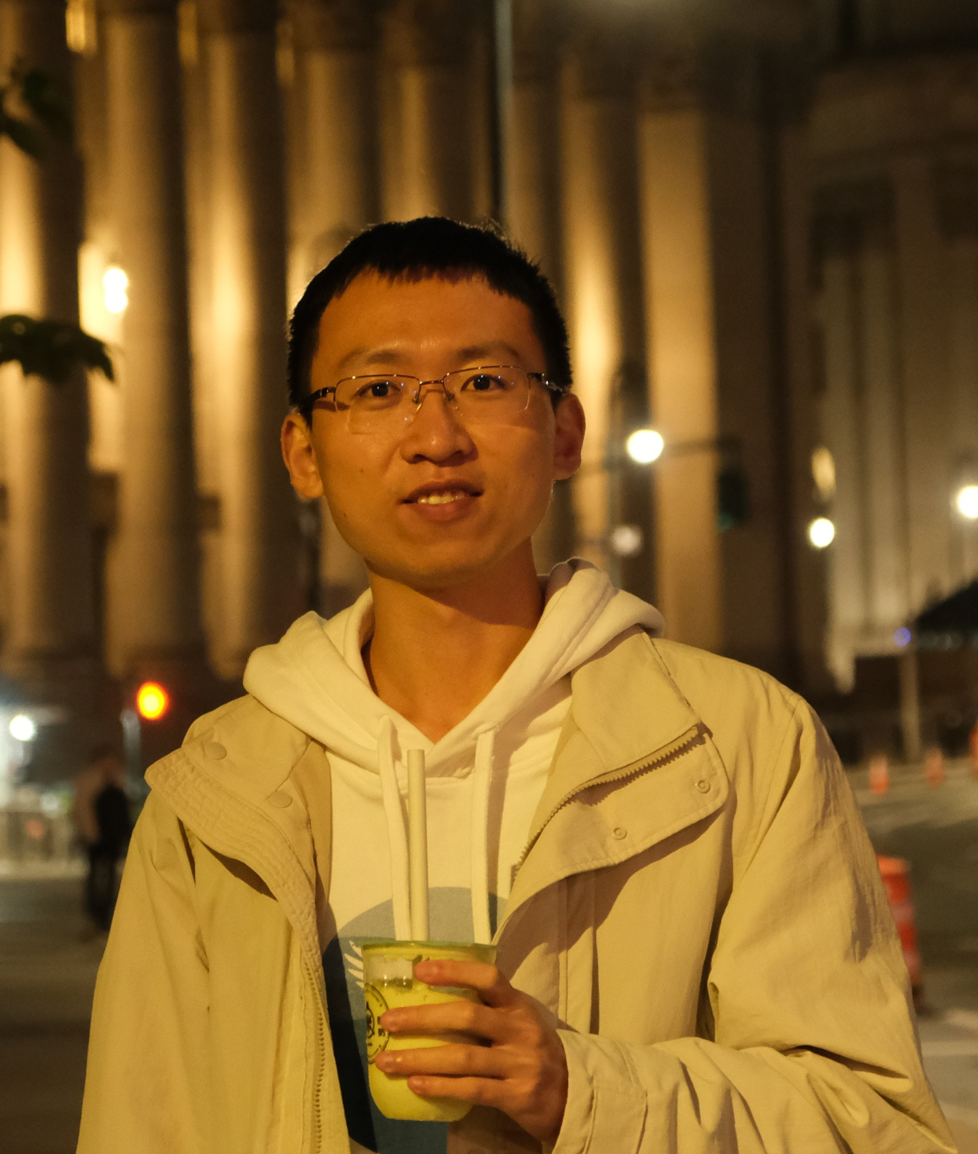
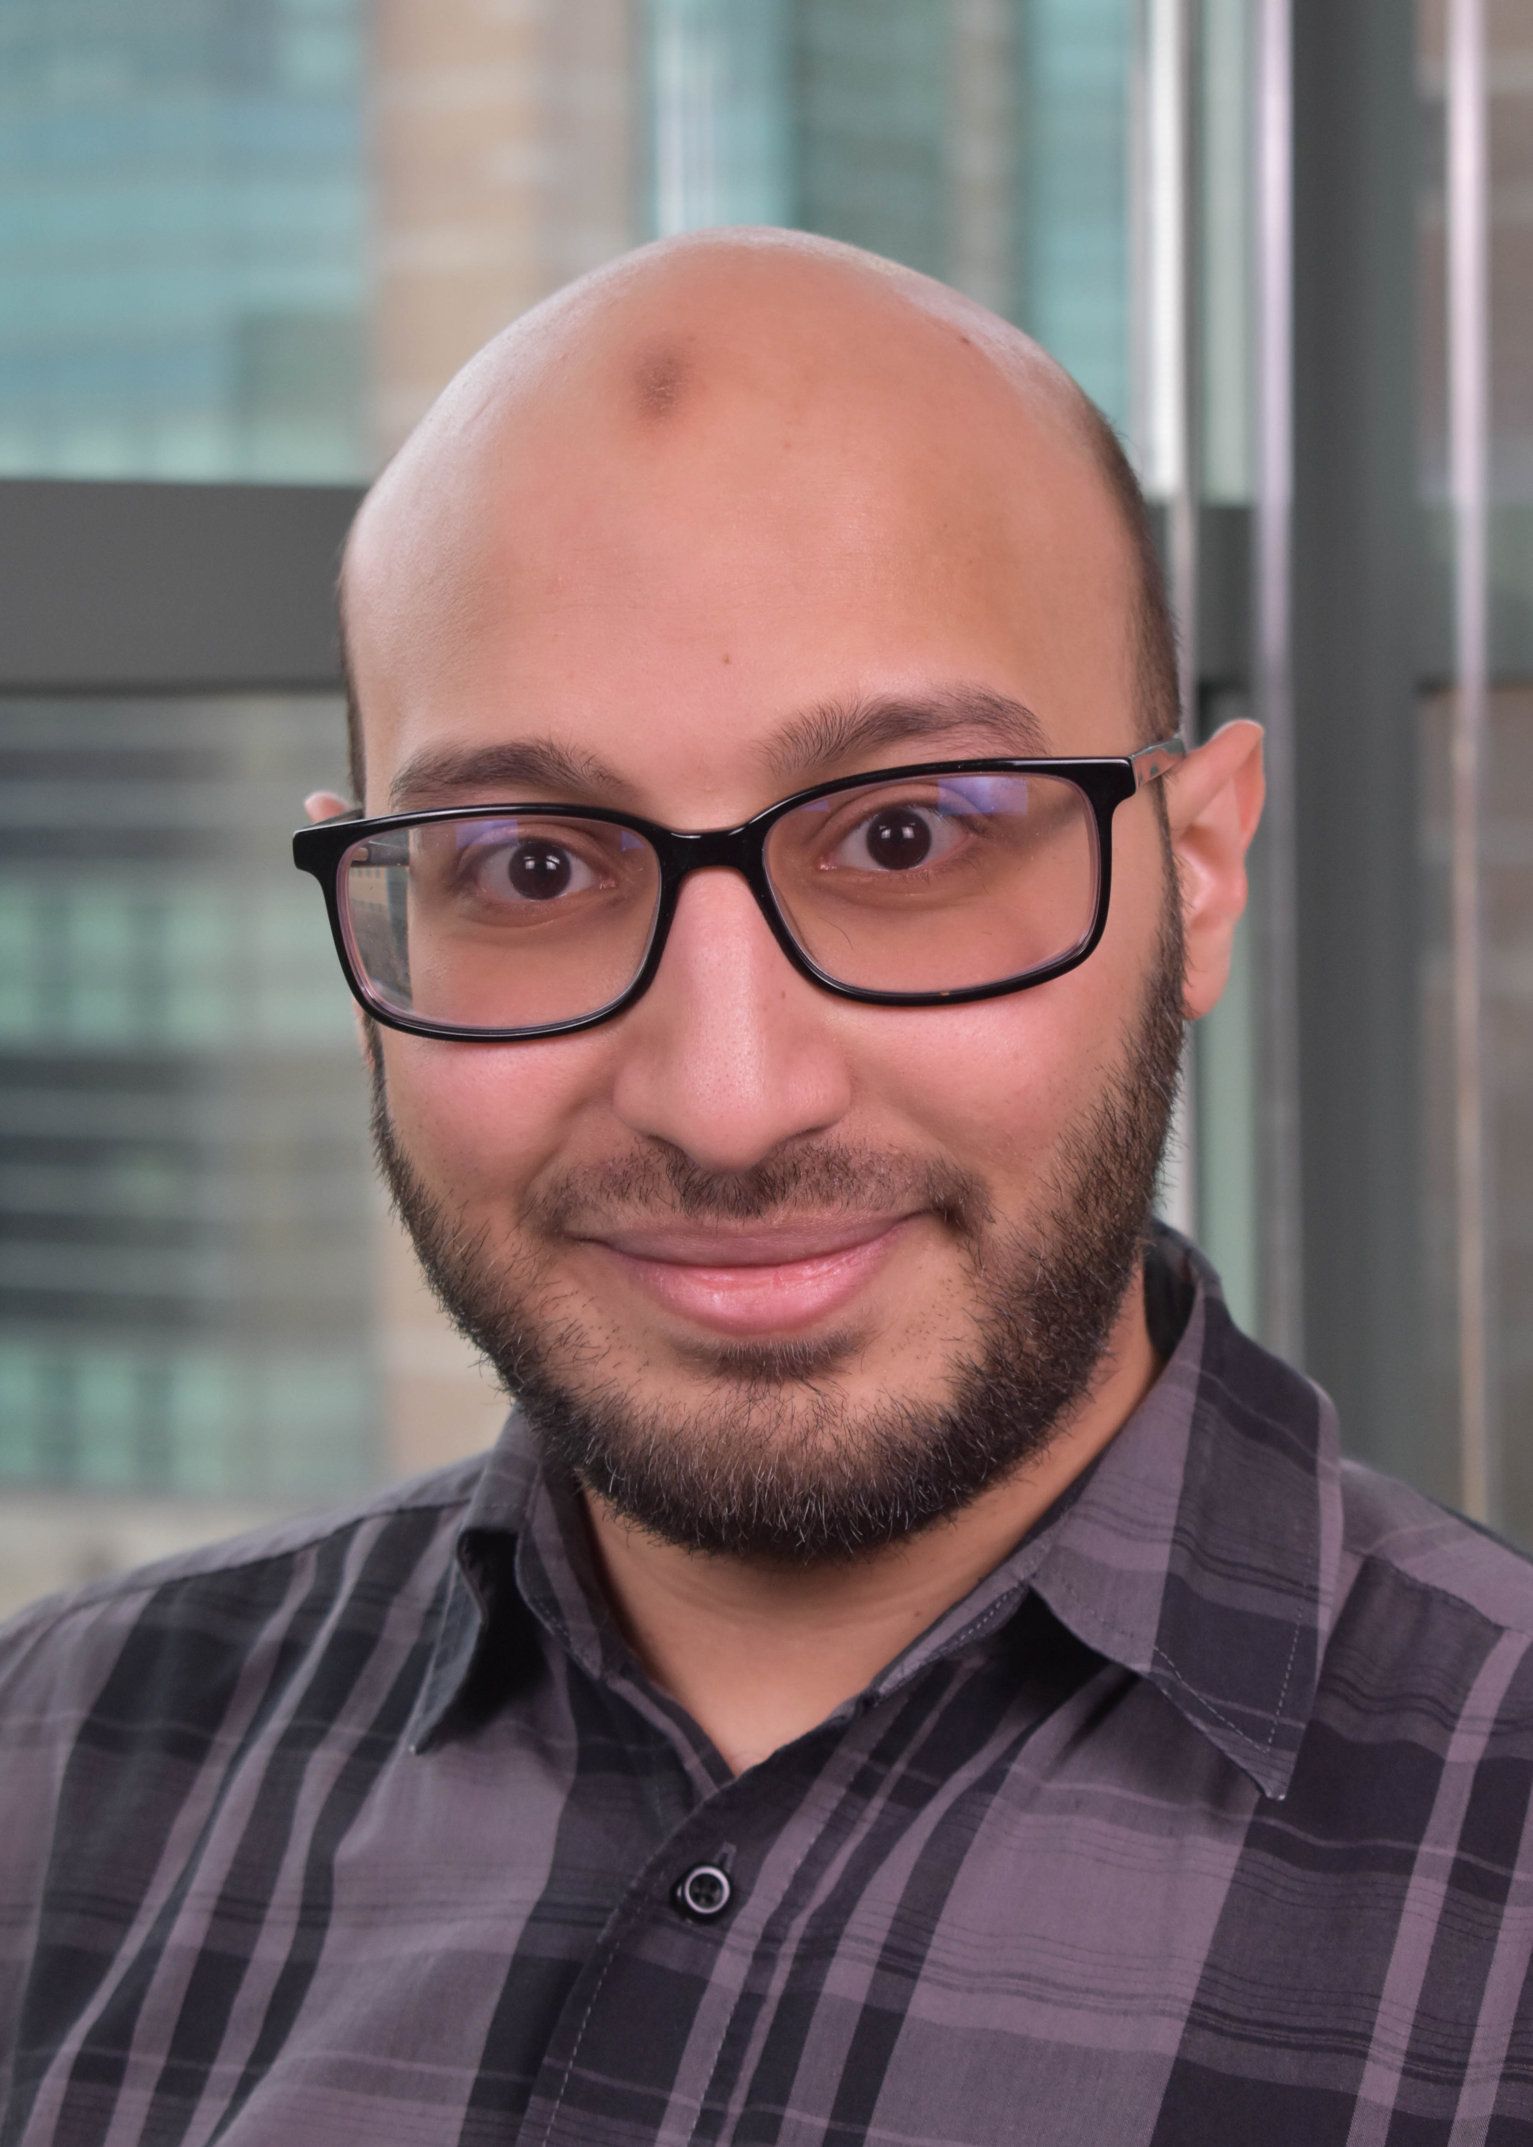
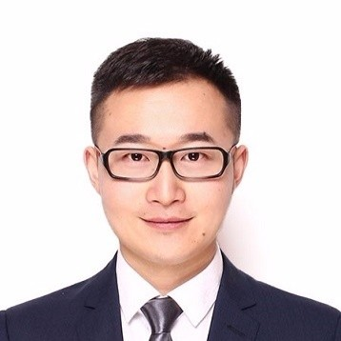
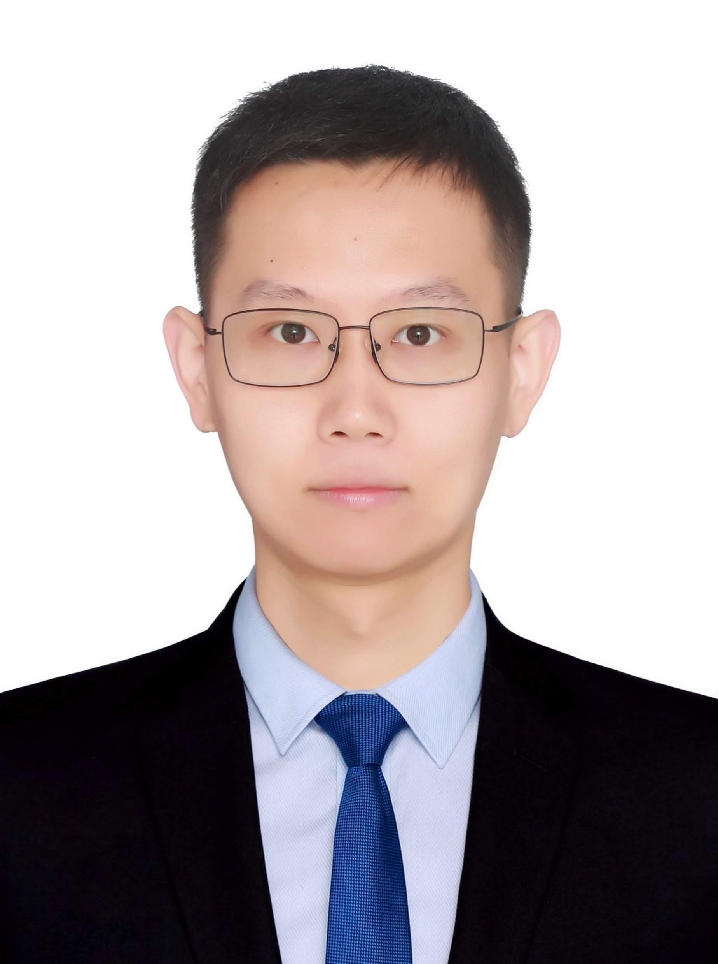
FAISys 2025
Special Thanks: Organizing Committee
General Chair
Hong Xu
The Chinese University of Hong Kong
General Chair
Chuan Wu
University of Hong Kong
PC Chair
Bin Cui
Peking University
PC Chair
Dmitrii Ustiugov
Nanyang Technological University Singapore
Sponsorship Chair
Registration Chair
Jingzong Li
Hang Seng University of Hong Kong
Sponsorship Chair
Abdurlrahman Mahmoud
Mohamd Bin Zayed University of AI
Publicity&Web Chair
Cheng Li
University of Science and Technology of China
Registration Chair
Qingyu Song
Xiamen University
Notes:
整张图片

Slide 8

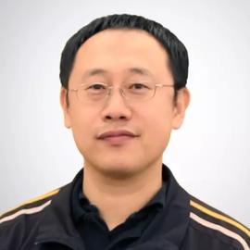
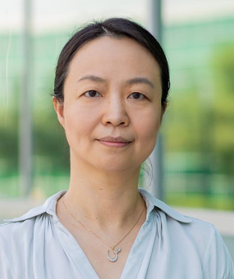
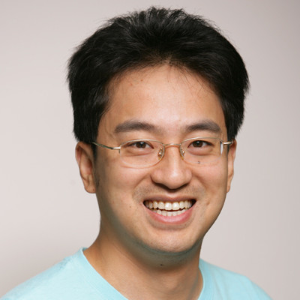
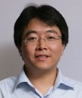
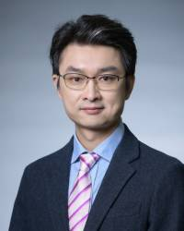
FAISys 2025
Special Thanks: Steering Committee
Wenguang Chen
Tsinghua University
Cheng Li
University of Science and Technology of China
Xiaosong Ma
Mohamed bin Zayed University of AI
Kun Tan
Huawei Technologies
Ji-Rong Wen
Renmin University of China
Yubin Xia
Shanghai Jiao Tong University
Hong Xu
The Chinese University of Hong Kong
Notes:
整张图片

Slide 9
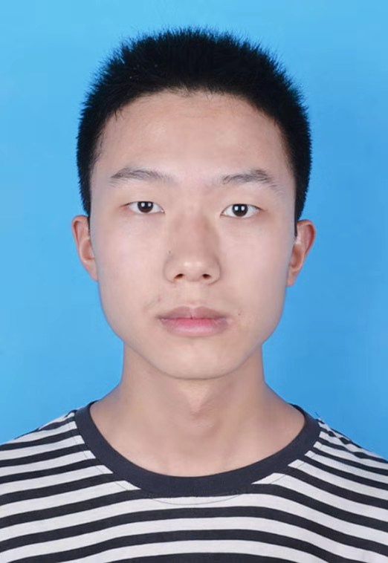
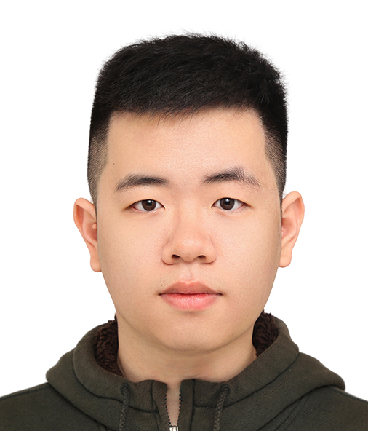
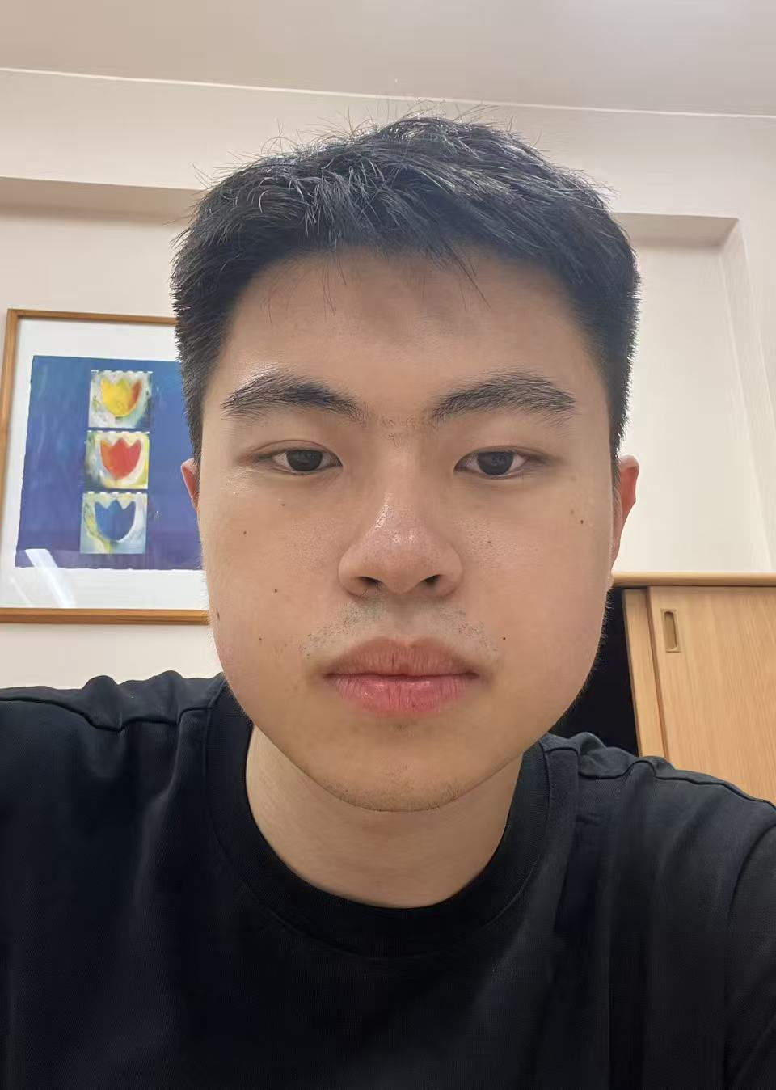
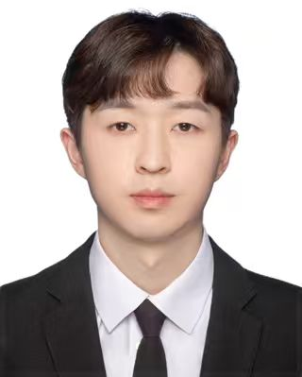
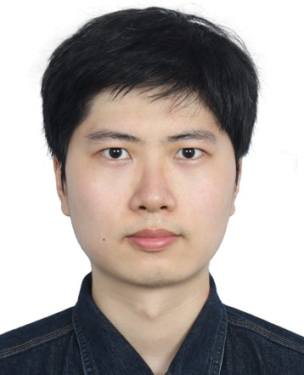
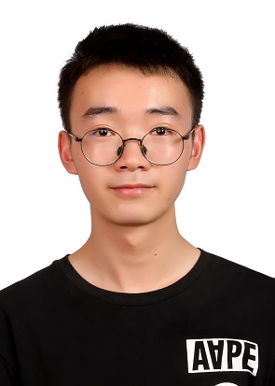
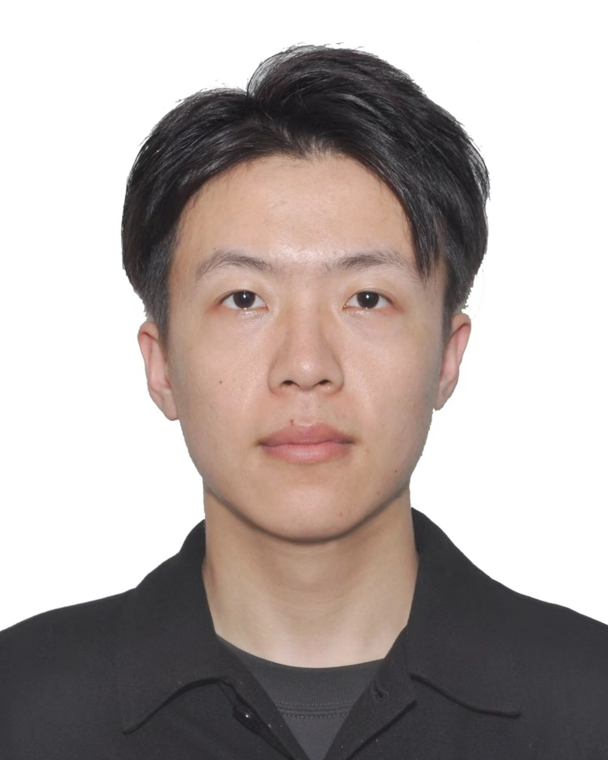
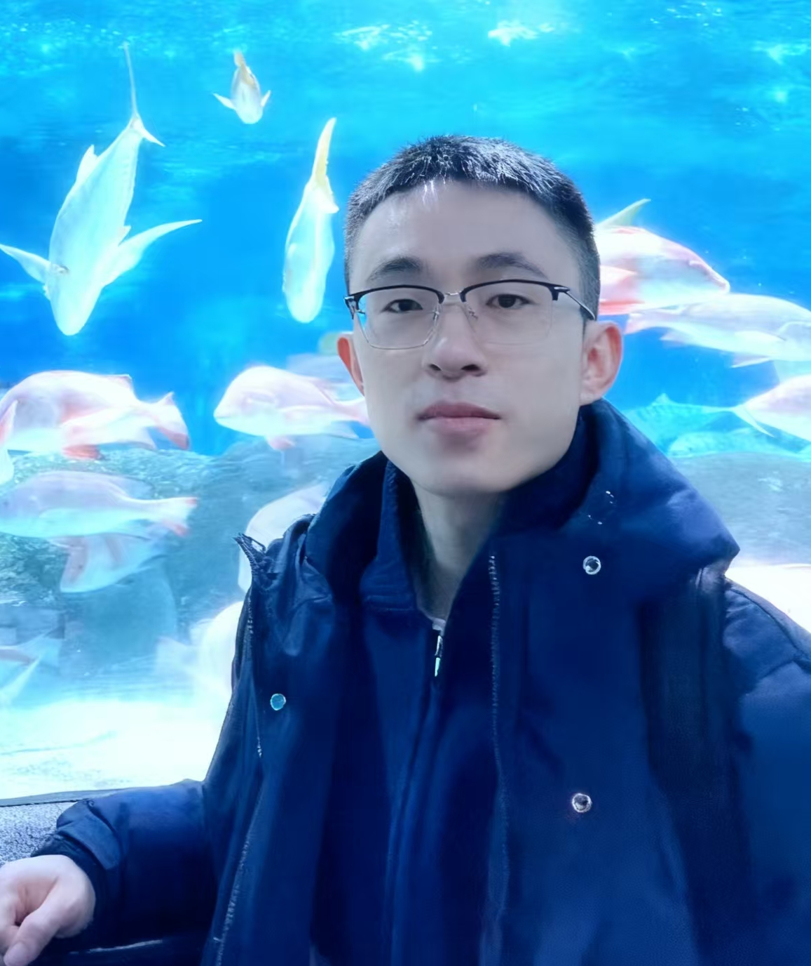
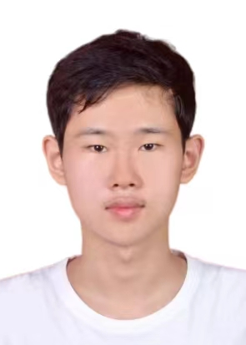
f02e818552667dd547946f71403f50a2.jpg
FAISys 2025
Special Thanks: Local Volunteers
Jingze Zhang
Wei Lin
Yitao Yang
Yicheng Feng
Yuetao Chen
Kaiwen Chen
Jianqiang Li
Yangtao Deng
Chaobo Jia
Notes:
整张图片

Slide 10




FAISys 2025
Special Thanks: Sponsors
Notes:
参会者分布备选方案三

Slide 11
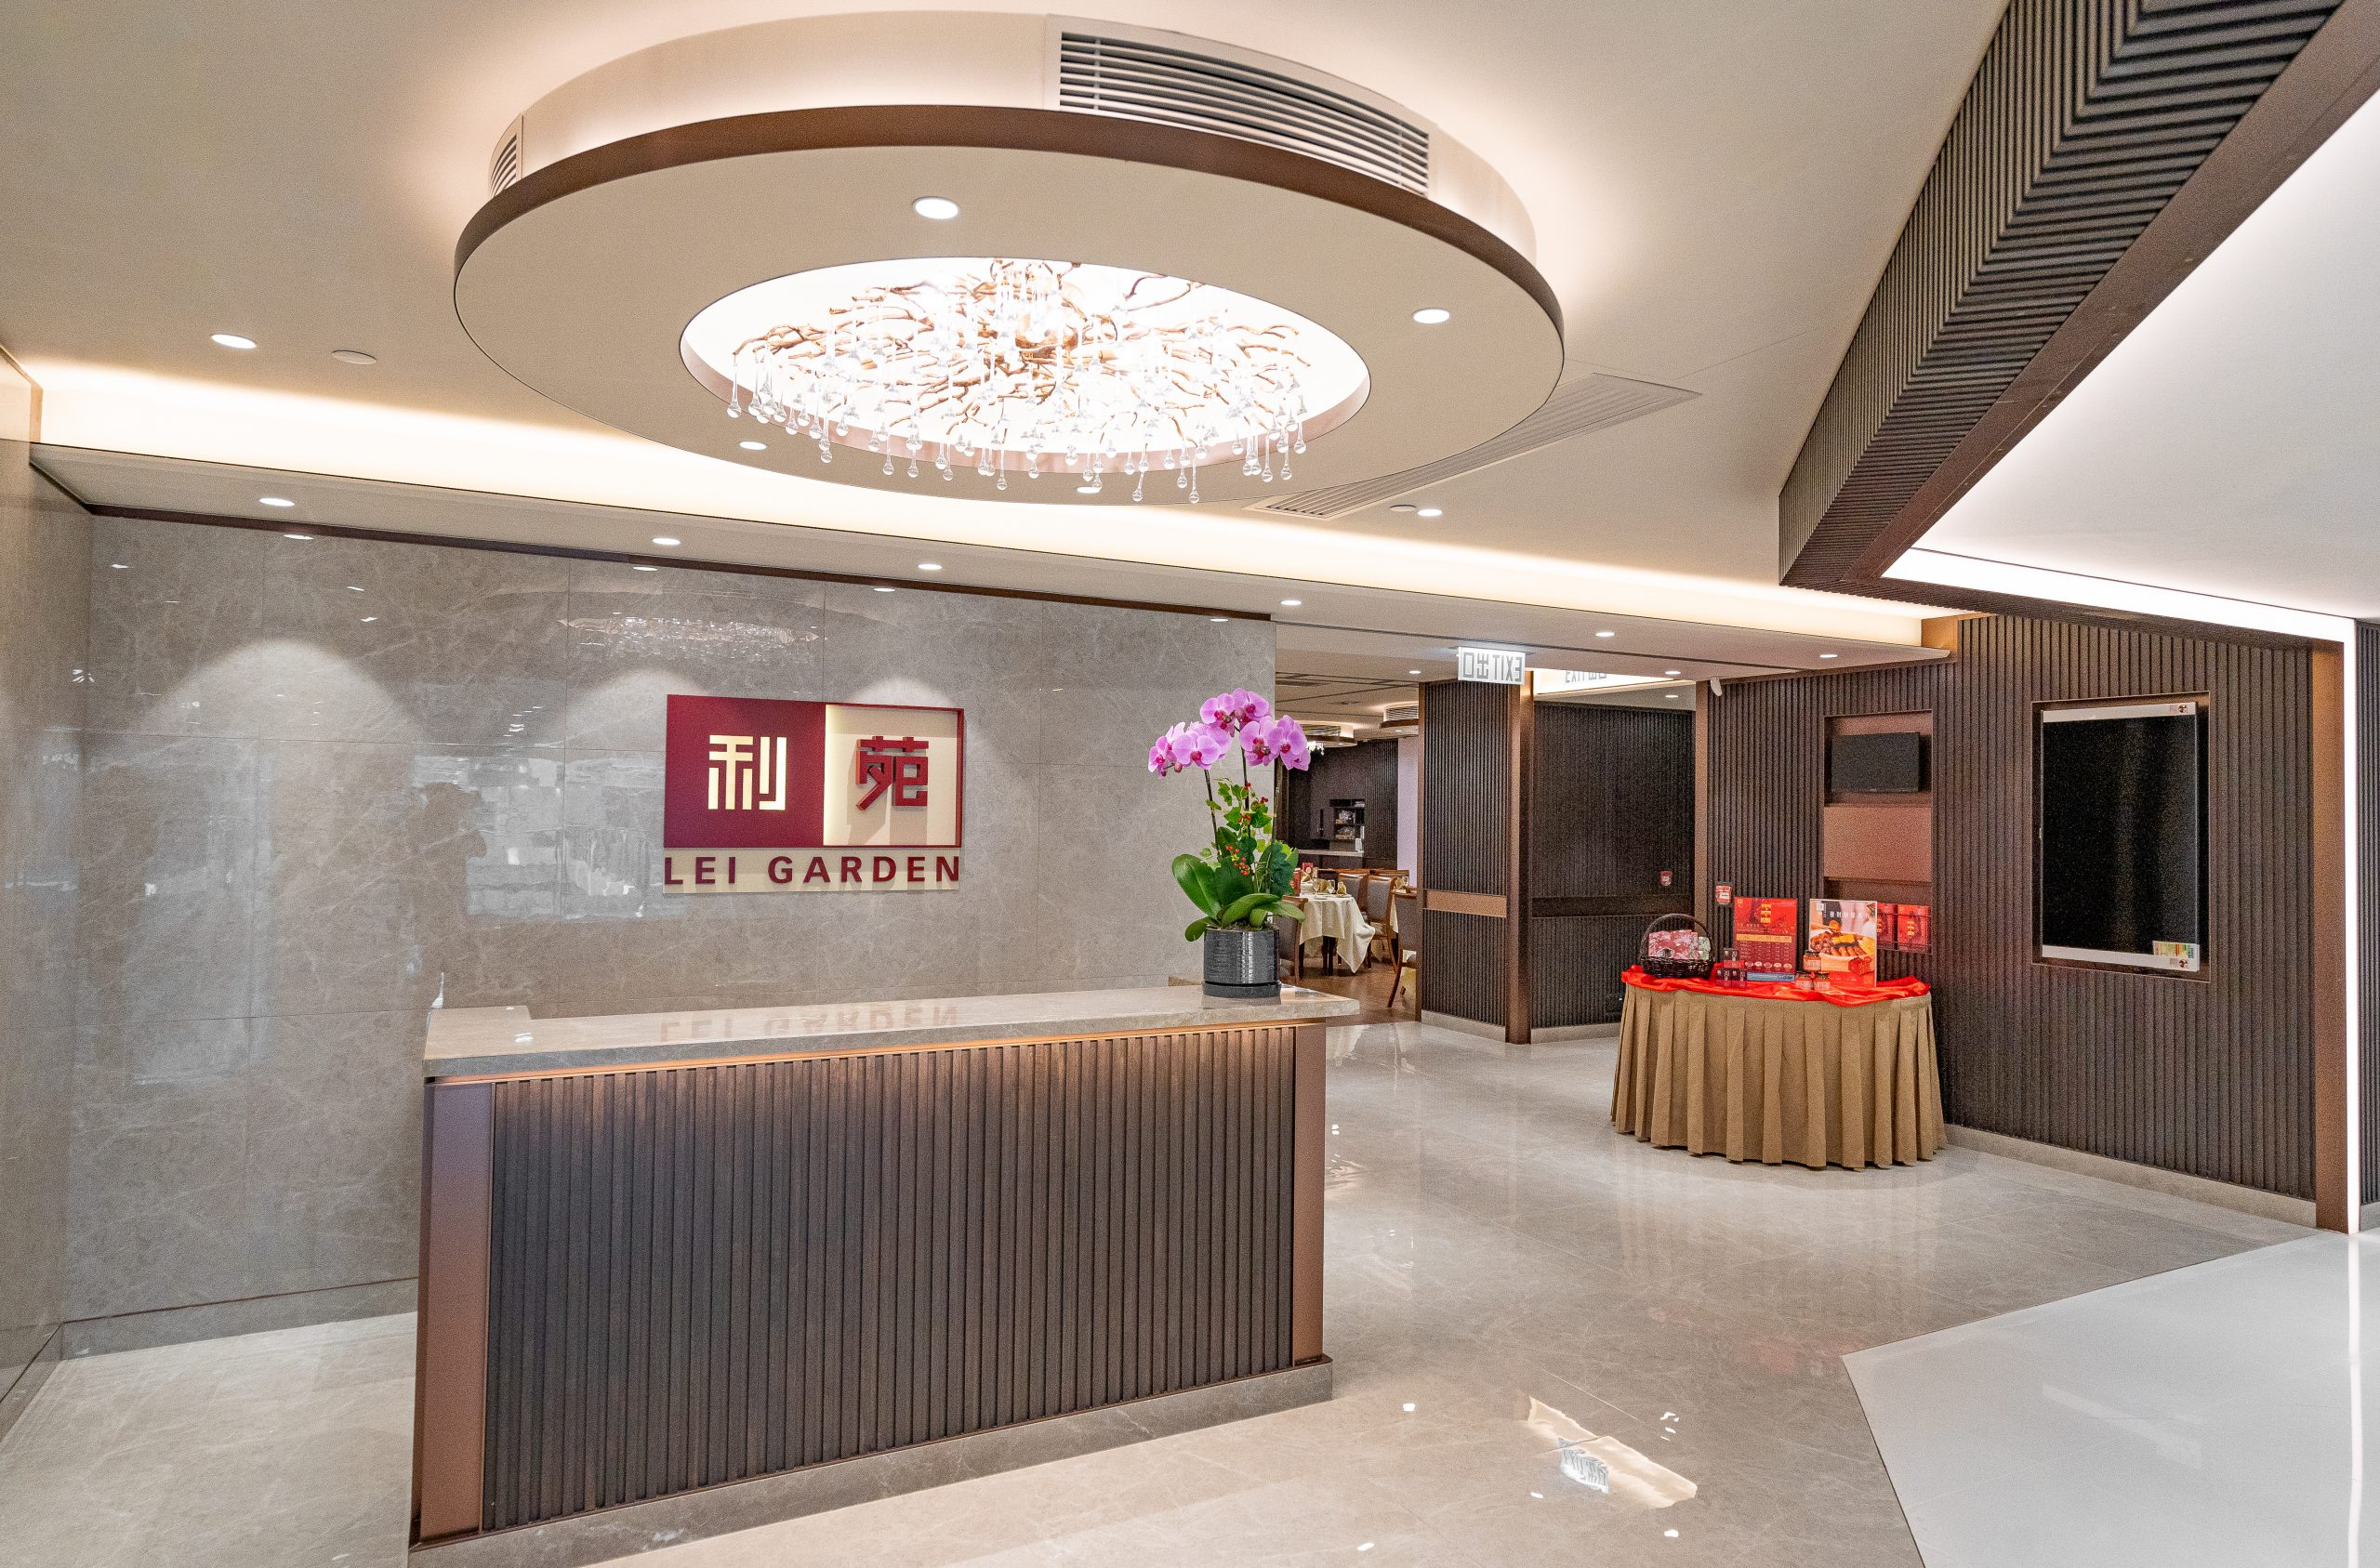
FAISys 2025
Banquet
Lei Garden, Shatin
New town plaza, phase 1
3 Shuttle buses for pickup at CYT (Cheng Yu Tong) building, on 5:30pm
Notes:
整张图片

Slide 12

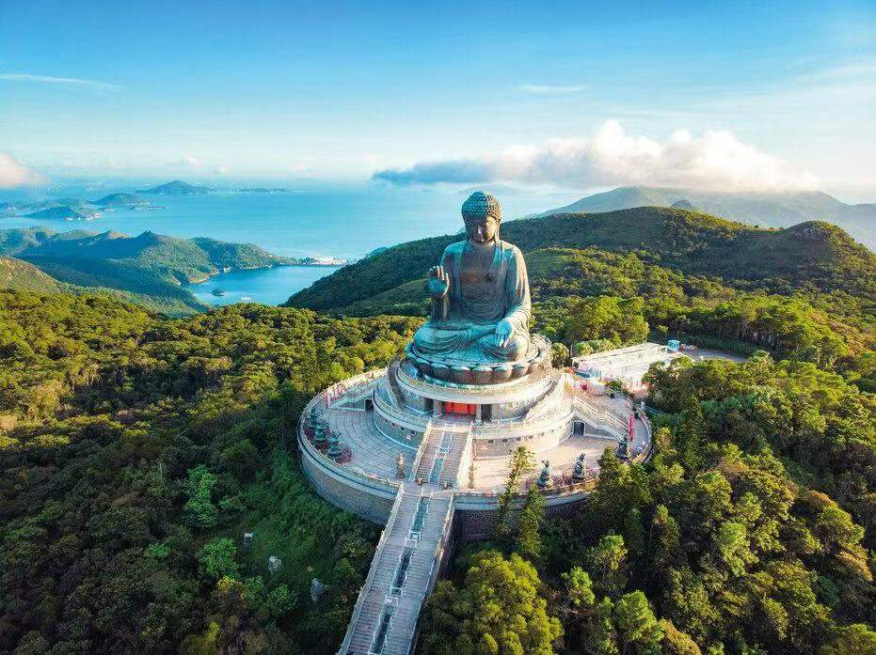
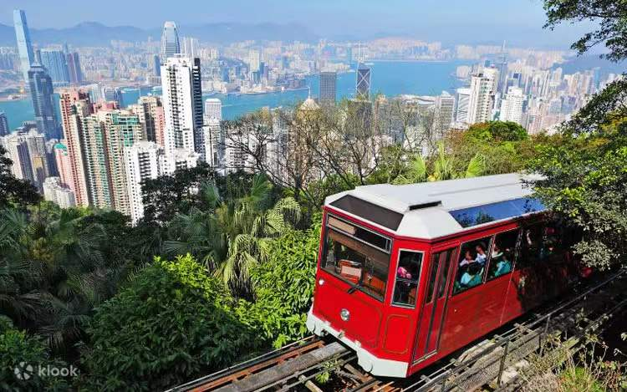
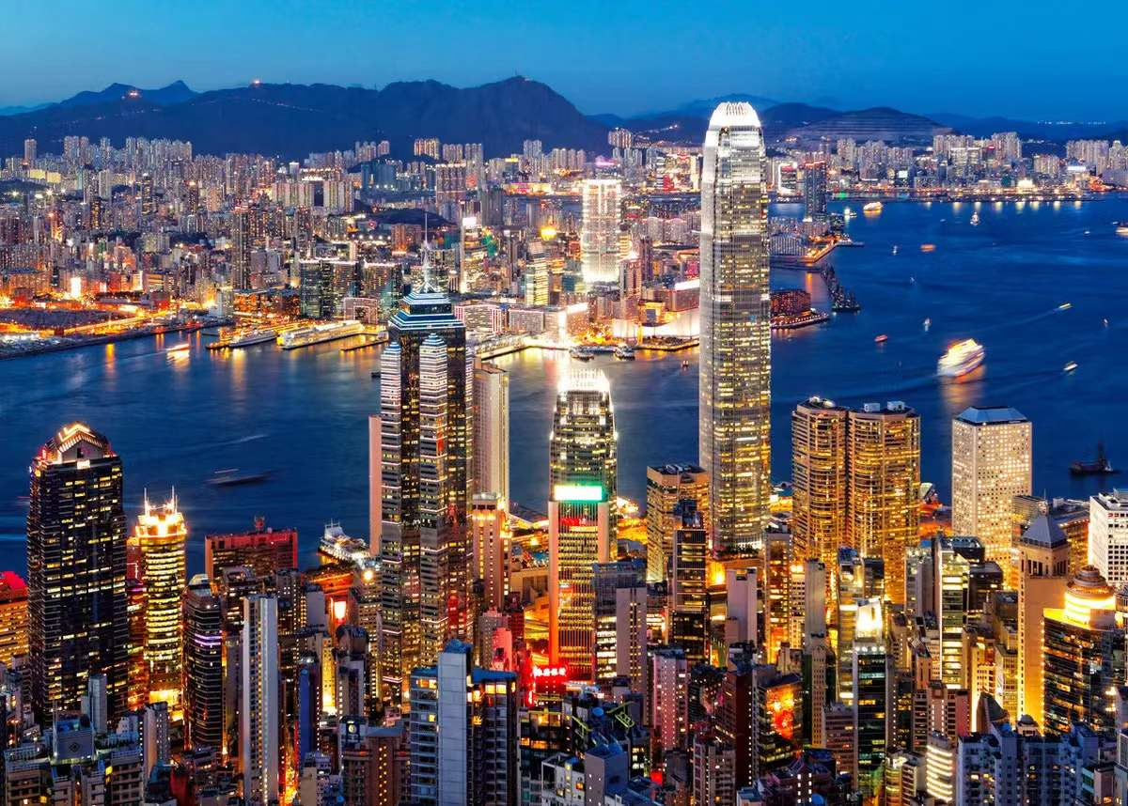
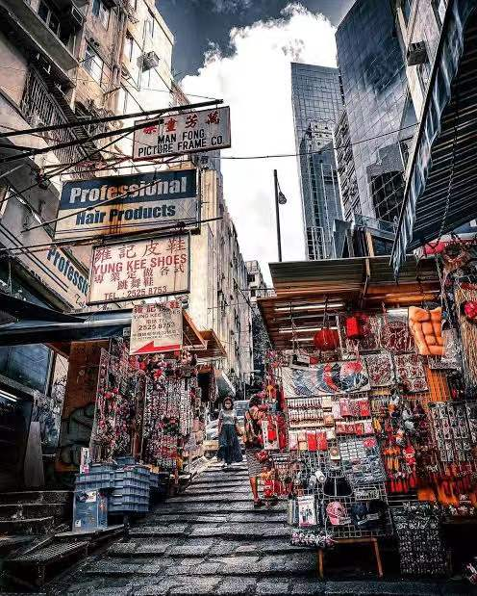
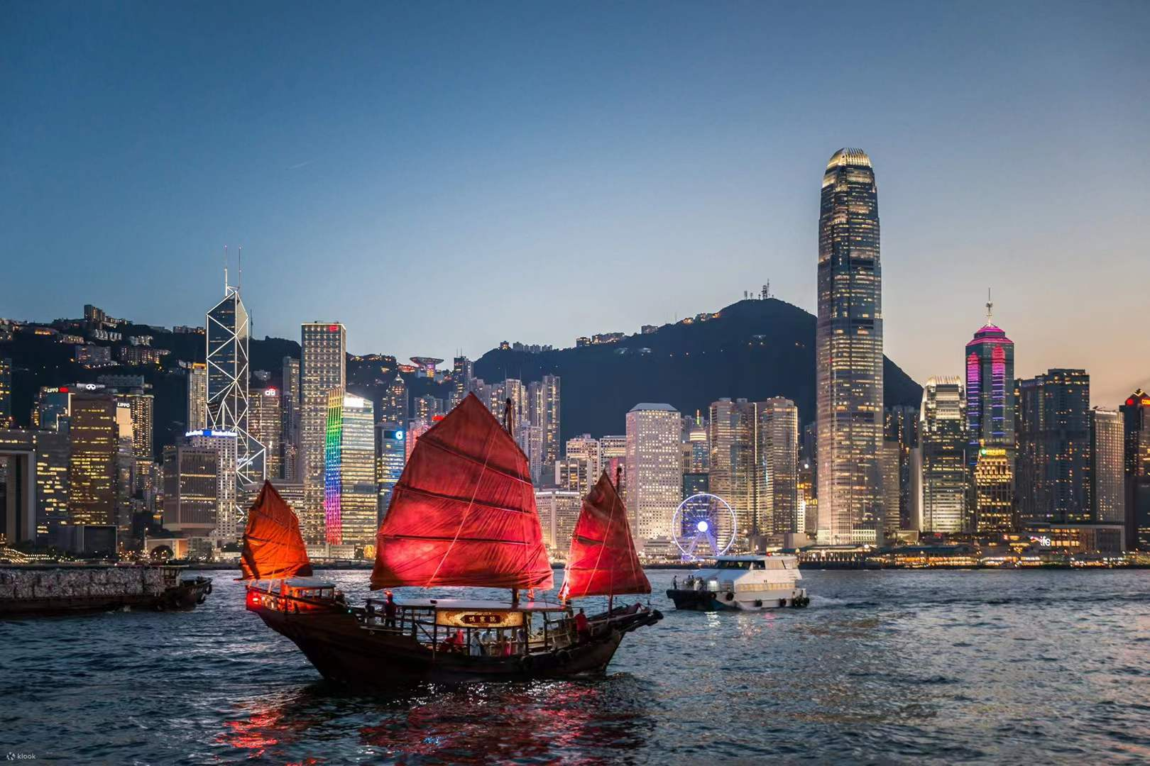

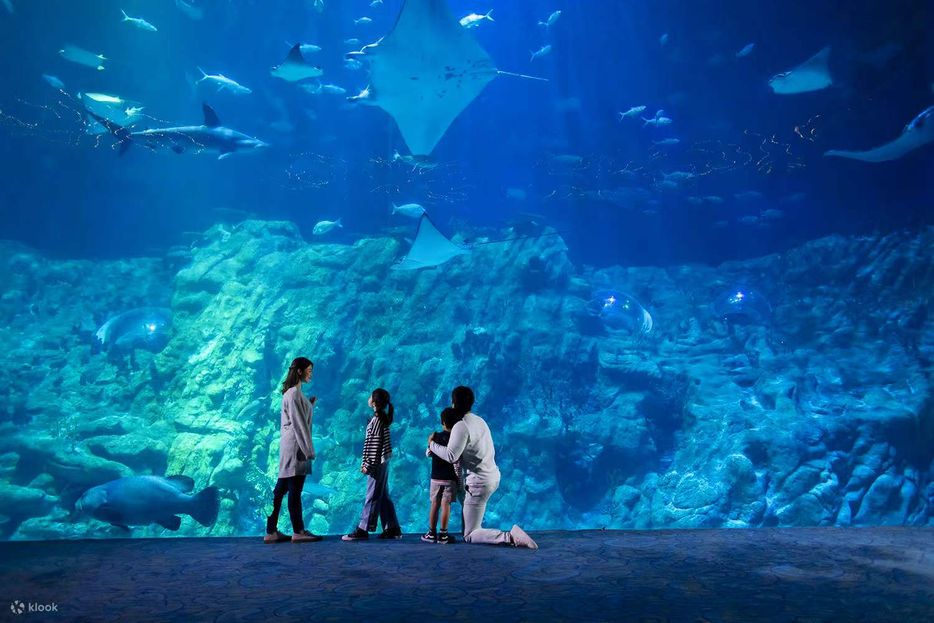
FAISys 2025
Welcome to Hong Kong
Notes:
左边文字右边图

